Slide 1


Algorithms on Graphs
Umang Bhaskar & Juhi Chaudhary
Day 1, session 2: Proofs on graphs
STCS Vigyan Vidushi 2024

Slide 2
Exercises: Day 1
Problem 1:
Give a polynomial time algorithm to test if a graph is bipartite.

Slide 3
Exercises: Day 1
Problem 1:
Give a polynomial time algorithm to test if a graph is bipartite.
show that $G$ is bipartite iff $G$ has no odd cycles

Slide 4
Exercises: Day 1
Problem 1:
Give a polynomial time algorithm to test if a graph is bipartite.
show that $G$ is bipartite iff $G$ has no odd cycles
use bfs to find odd cycles

Slide 5
Exercises: Day 1
Problem 2:
Show that every MST must include both edges with weight 1.
3
a
b
10
7
1
4
c
f
8
1
2
e
6
d

Slide 6
Exercises: Day 1
Problem 2:
Show that every MST must include both edges with weight 1.
how do you characterize a spanning tree?
3
a
b
10
7
1
4
c
f
8
1
2
e
6
d

Slide 7
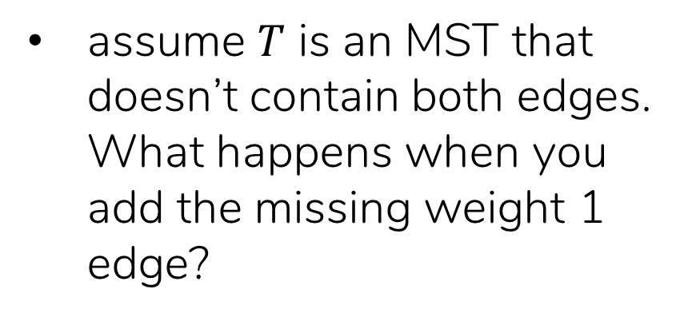
Exercises: Day 1
Problem 2:
Show that every MST must include both edges with weight 1.
how do you characterize a spanning tree?
3
a
b
10
7
1
assume $T$ is an MST that doesn’t contain both edges. What happens when you add the missing weight 1 edge?
4
c
f
8
1
2
e
6
d

Slide 8

Exercises: Day 1
Problem 3: Find all shortest-paths from vtx a
4
Dijkstra ( $G=(V,E)$ , a)
a
b
3
1
dist(a) = 0, dist(v) = ∞ for all others
8
S = {a} \\ set of shortest-distance vertices
c
4
6
update distance for vtxs adjacent to a
d
h
3
while S $≠$ V
3
add vtx v with smallest dist to S
2
3
e
update distance for vtxs w adjacent to v
6
2
3
add directed edge (v,w)
(and remove other edges into w)
i
f
g

Slide 9
Exercises: Day 1
Problem 4:
Prove that Dijkstra’s algorithm terminates correctly.

Slide 10
Exercises: Day 1
Problem 4:
Prove that Dijkstra’s algorithm terminates correctly.
prove that it terminates.

Slide 11
Exercises: Day 1
Problem 4:
Prove that Dijkstra’s algorithm terminates correctly.
prove that it terminates.
prove that when a vertex is added to S, it’s distance is shortest-path distance.

